Slide 1
A.3 Why fitness components are important for successful participation in given sports
Performer
Physical demands
Skill related demands
Consider the type of event / position played
Perform efficiently

Slide 2
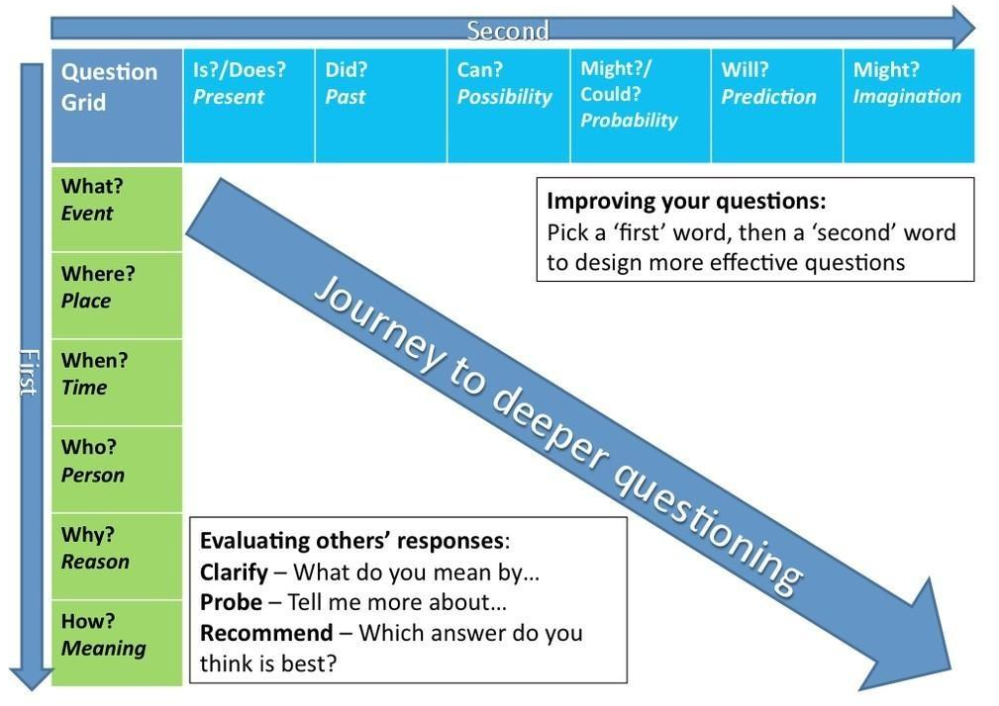
Watch the video and devise questions that you’d like answered.

Slide 3
PMI
Positive | Minus | Interesting

