Slide 1
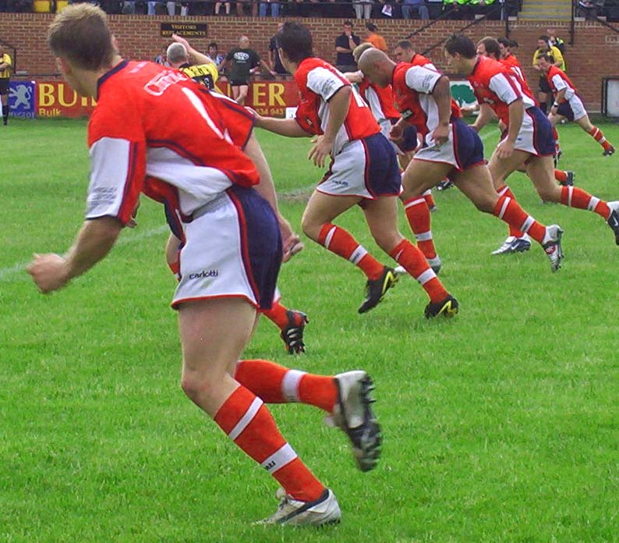
Name two aerobic tests

Slide 2
Task
What equipment will you use?
What are the pre-test procedures?
What are the instructions?
How do you record / measure the results?
How do you compare results?
What are the advantages / disadvantages of each test?

Slide 3
Fitness testing methods
Flexibility (Sit & Reach test)
Strength (Grip Dynamometer)
Aerobic Endurance (Various tests)
Speed: 35m sprint
Speed and agility (Illinois agility run)
Anaerobic power (Vertical jump test)
Muscular endurance(1 minute tests)
Body composition (Various tests)

Slide 4
Aerobic Endurance
Tests
Multi-stage Fitness Test
Forestry step test
VO₂ Max Definition: “maximum amount of oxygen update, usually measured in ml of Oxygen per kg of body mass per minute. Measures cardiorespiratory endurance

Slide 5
Multi-stage fitness test
Two lines placed 20m apart
Start line – wait for triple bleep
Reach other line before/on time with beep
Turn and repeat.
Bleeps get quicker as the test progresses
Continue for as long as you can

Slide 6
Multi stage fitness test

Slide 7
Advantages and Disadvantages
Advantages
Can test a large group at once
Tests to maximum effort
Easily compare to normative data
Disadvantages
Practice can affect score
Need 20 m area

Slide 8
Forestry step test
Males – Bench height – 40cm
Females – Bench height – 33cm
Stepping rate – 22.5 steps per minute (both males and females)
Metronome set to 90 beats per minute

Slide 12
Score | Males (15-19) (ml/kg/min) | Females (15-19) (ml/kg/min)
Excellent | 60+ | 54+
Good | 48-59 | 43-53
Average | 39-47 | 35-42
Below average | 30-38 | 28-34
Poor | <30 | <28

Slide 13
Forestry step test
Measure weight in Kg before beginning test
Face bench
Step in time with metronome
Up – Up – Down – Down (Alternate feet)
Stand straight when stepping onto the bench
Step for 5 minutes
Record pulse at two15 sec intervals at end of test

Slide 14
Advantages and Disadvantages
Advantages
Low cost
Stepping is natural
Easily compare to normative data
Disadvantages
Testing large groups will be very time consuming
Need equipment
Danger of tripping

