Slide 1
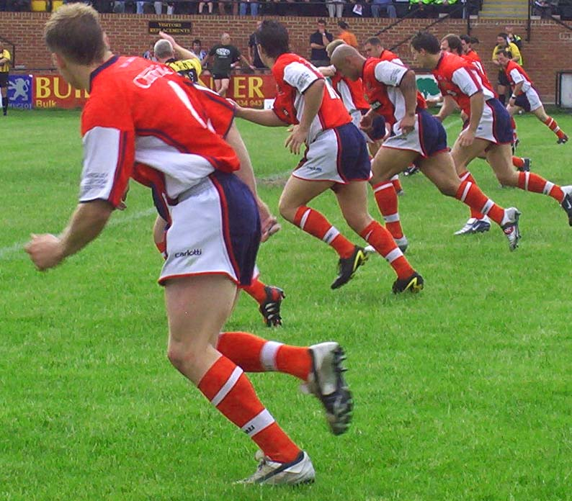
Why do we need fitness tests?

Slide 2
Task
Fitness testing for Year 10
What equipment will you use?
What are the pre-test procedures?
What are the instructions?
How do you record / measure the results?
How do you compare results?
What are the advantages / disadvantages of each test?

Slide 3
Fitness testing methods
Flexibility (Sit & Reach test)
Strength (Grip Dynamometer)
Aerobic Endurance (Various tests)
Speed: 35m sprint
Speed and agility (Illinois agility run)
Anaerobic power (Vertical jump test)
Muscular endurance(1 minute tests)
Body composition (Various tests)

Slide 4
Importance of fitness testing
Gives baseline data for monitoring/improving performance
Design programme based on test results
Can assess effectiveness of training programmes
Results can help performers to set training goals

Slide 5
Pre-test procedures
Need informed consent of clients. Why?
Screening documents
Equipment needs to be calibrated to ensure accuracy

Slide 6
Reliability
If you were to carry out the same test again, you should expect the same results
Test can be repeated
Will produce same results

Slide 7
Validity
How accurate are the results that you have obtained
Have the results measured the fitness component that they set out to

Slide 8
Practicality
Aspects that can influence the test
Logistics: Equipment needed
Facilities required
Numbers of participants

