Slide 1
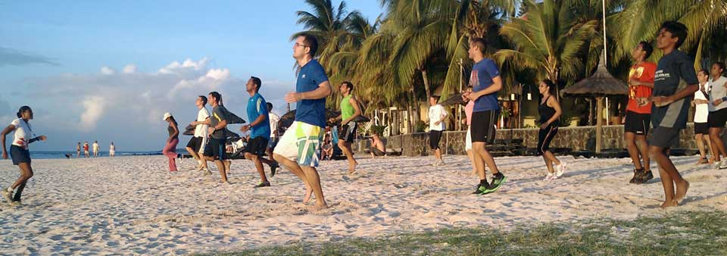
B1 & B2 Training methods Describe how you prepare for exercise?

Slide 2
Home learning
Devise a warm up and cool down for your chosen sport. Ensure you include activities and timing for each of the three phases.

Slide 3
Warming up and cooling down
How would you advise Year 7 pupils to warm up and cool down?
How would this differ for professional football players?

Slide 4
Questions: Page 12
Why should you warm up? (2 marks)
Name and describe the three phases of a warm up. (6 marks)
Why should you cool down? (1 mark)
Name and describe the three phases of a cool down? (6 marks)

Slide 5
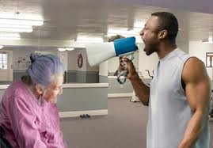
Question time
Before you take part in any form of regular training list 5 things you must do.

Slide 6
Conducting fitness tests
Things to consider | Why?
Safe and correct use of equipment
Safe and correct application of equipment
Warm up
Cool down
Apply the FITT principle
Apply the ‘S’ principle from SPORV R & R

Slide 7
Prove it review
What were the outcomes for today’s lesson?

