Slide 1
Green pen homework
Can anyone share good practice?
What are the key learning points?

Slide 2
Extended essay
CUS the question
Divide the question and bullet point a plan
Knowledge
Application (example)
Evaluate / Analyse (worth / break down into components)

Slide 3
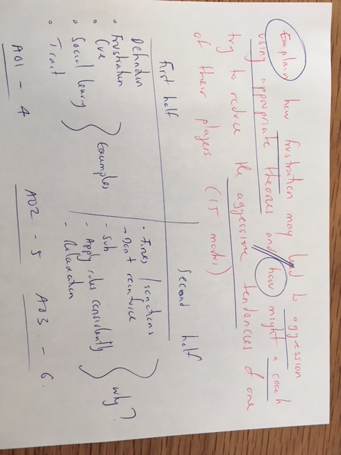

Slide 4
Homework
Choose one of the psychological areas reviewed so far for your coursework. Outline how this contributed to your area for development and explain a strategy for you to improve.
Example:
Arousal - over arousal (Theories etc)
Cognitive techniques

Slide 5
Last week’s lesson

Slide 6
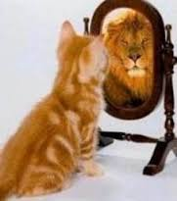
What message do you get from these pictures?

Slide 7
Page 94 Book 2
What is the difference between state and trait confidence? Pg 95
Characteristics of self efficacy, self confidence and self esteem

Slide 8
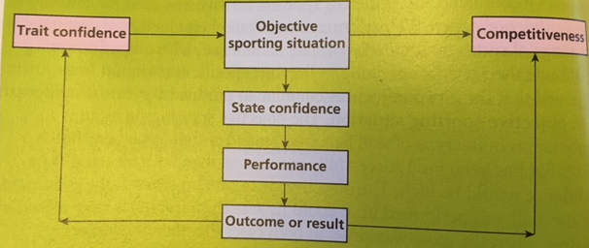
Make notes and link this to your sport
Vealey

Slide 9
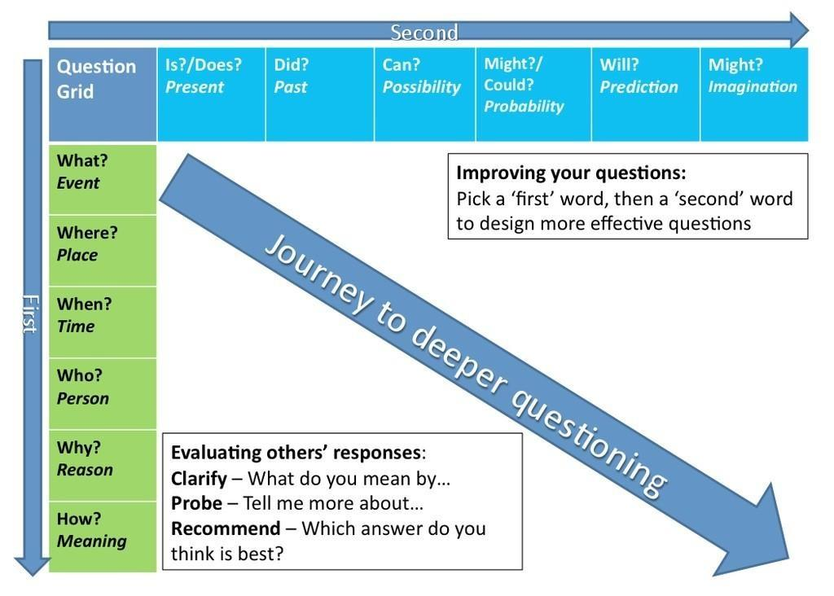

Slide 10
Characteristics
Low self efficacy | High self efficacy

Slide 11
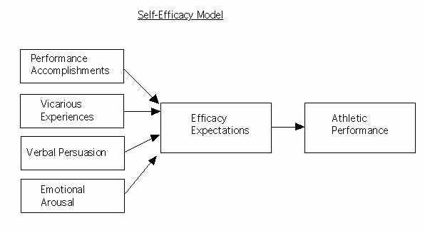
Bandura’s model – Page 197

Slide 12
How does self efficacy affect you?
Choice of activity
Amount of effort applied
Level of persistence

Slide 13
Task
You are the Happy’s coach. He is going through a rough patch and is showing signs of low levels of self efficacy. Using Bandura’s model how could you turn this around.
Discuss in pairs and then write four paragraphs.

Slide 14
Strategies to develop high levels of self efficacy

Slide 15
Home and away - Videos
Advantages | Disadvantages

