Slide 1
Homework

Slide 2
KQ

Slide 3
Book 1 Page 202

Slide 4
What are the benefits of goal setting (3 marks)
What’s the difference between an outcome or product goal?
What’s a task orientated goal?
What’s the difference between a performance and process goal?

Slide 5
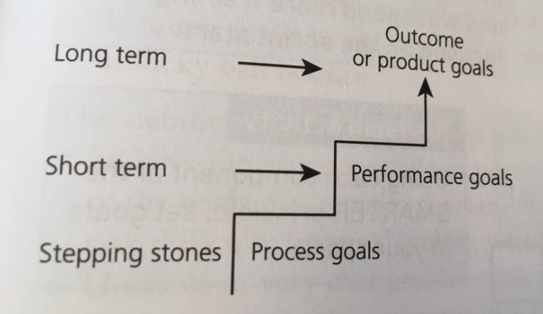
Place the types of goal in order of short – long term / order of importance

Slide 6
What factors must a coach consider when setting goals?

