Slide 1
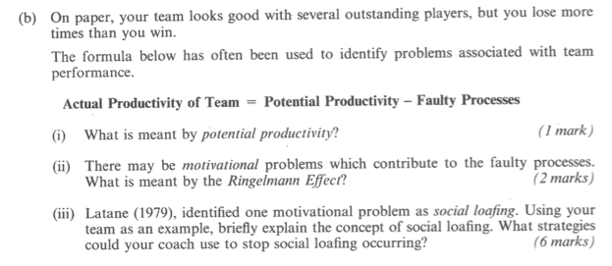
Review of learning from last week. Exam question from 1995.

Slide 3
Arsenal

Slide 4
Leadership

Slide 5
Leadership and group cohesion
How does Arsene develop group cohesion?
Is he an effective leader?

Slide 6
What are the qualities of a good leader?
Devise an acronym.
Mine is GIVE HOPE

Slide 7
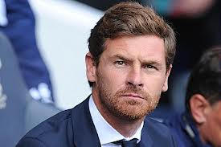
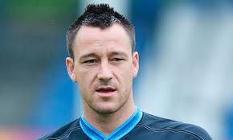
How do we select / appoint leaders?
Prescribed leader
Emergent leader

Slide 8
Exam question (2011)
Identify three characteristics of a good leader and explain the difference between an emergent and prescribed leader (3 marks)
Need three from – confident, orgainsed, inspirational, good communication, knowledgeable, good decision maker, motivational,
Emergent – elected by the team
Prescribed – appointed by an external authority

Slide 9
Prep homework. What did you learn about the theory and its limitations?
Great Man Theory
Nature versus nurture
Social Learning Theory
Interactionist Theory
PM Table
Positive | Minus

Slide 10
Leadership styles. What are the ideal condition/situation for its use?
 | Definition | Ideal condition
Authoritarian or autocratic leader
Democratic leader
Laissez-faire leader

Slide 11
Were the videos useful?
Fielder’s Contingency model
2. Chelladurai’s Multi-dimensional model

Slide 12
Review

Slide 13
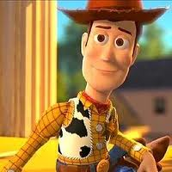
Link all of your learning from the lesson
Is he an effective leader?

Slide 14
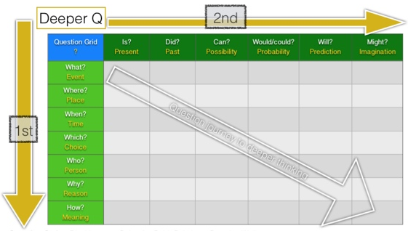
What do you want to learn about leadership? Unanswered questions.

Slide 15
Exam question
Explain what Chelladurai’s multidimensional model suggest about leadership (7 marks)

Slide 16
Answer

