Slide 1
Personality – Book 1 Page 162
Lesson 1 of 2

Slide 2
Year 12 revision KQ

Slide 3
Speed reading task

Slide 4
Home learning 1
Write an essay to discuss the following statement
‘How can knowledge of the interactionist perspective help performance in your chosen sport?’ 8 marks (K,A,A)

Slide 5
Home learning 2
Describe and explain with practical examples:
Need to achieve (nAch)
Need to avoid failure (NaF)
Key words: Approach behaviour, avoidance behaviour, self efficacy
Challenge key words: learned helplessness, attributions
On no more than 1 side of A4 for each

Slide 6
Questions that psychologists have been studying
Is there a relationship between personality type and the sport people choose?
Why do some people prefer individual sports over team sports?
What do basketball players have in common with other basketball players in terms of their personality?

Slide 7
Outcomes
Apply your understanding to support answering an essay question (some independent research will be required)
Describe theories relating to personality – trait, social learning, interactionist approach, Hollander and lewin’s model

Slide 8
Nature vs nurture and traits

Slide 9
What is personality?
An individual’s predisposition to behave in a certain way.

Slide 10
Exam tip
When answering examination questions, remember that personality theory is concerned with how we behave or act.

Slide 11
Personality TIPS!
Make sure you learn the specific definition of personality!
Have awareness of the links between personality and sports performance.
It is important to understand the NATURE (trait) V NURTURE (social learning) and interactionist perspectives of behaviour.
Learn the strengths and weaknesses of each perspective.
Be aware of the problems associated with the use of personality profiling in sport.

Slide 12
Personality Theories
NATURE
vs
NURTURE
Social Learning Theory (Bandura)
“All behaviour is learned through interaction with the environment”
BEHAVIOUR = FUNCTION OF ENVIRONMENT
-ve = Does not consider inherited behaviour (traits)
Trait Theory (nature)
“People are born with established personality characteristics”
Inherited at birth.
Stable
Enduring
consistent in all situations.
BEHAVIOUR = FUNCTION OF PERSONALITY
+ve = Can be easily measured through questionnaires
-ve = Does not take into account environmental influences. It is not a true indicator of behaviour.
CATTELL (1965) identified 16 personality traits
INTROVERT & EXTROVERT
Evaluate each theory
Interactionist Theory
“Behaviour occurs from the interaction between inherited traits and learned experiences”
BEHAVIOUR = FUNCTION OF PERSONALITY × ENVIRNOMENT
Lewin and Hollander

Slide 13
Personality Theories
Interactionst Theory
Lewin (1936) proposed the formula
B = F (PE)
Where B = Behaviour f = function P = Personality and E = Environment
Work of Hollander is an example of the interactionist theory

Slide 14
Personality Theories
Concentric Ring Theory (Hollander 1967)
Role Related Behaviour – Surface of personality
Typical Response – Your usual response in most situations
The Psychological Core – The ‘real you’
The boundary line of each layer gets wider as you get closer to the centre of the model which shows that each layer is harder to enter. As you move closer to the centre, your ‘real’ personality begins to surface

Slide 16
Approaches
Credulous
Sceptical

Slide 17
How can knowledge of the interactionist perspective help performance ? Page 165

Slide 18
Question time

Slide 19
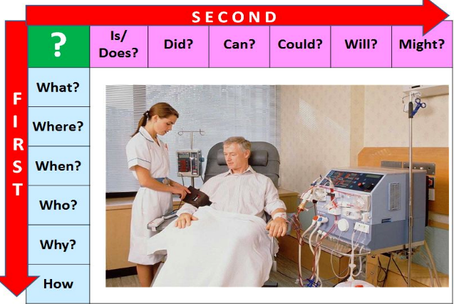
Question time

Slide 20
RAG review your syllabus

Slide 21
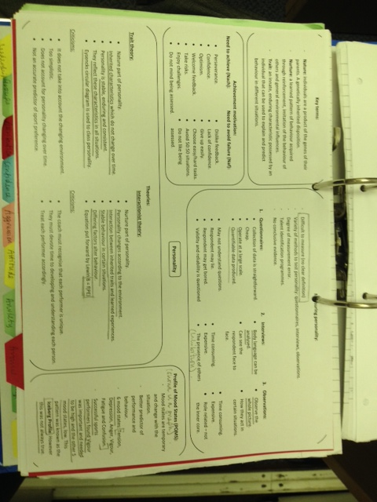

Slide 22
Cue cards / Knowledge quizzes

